Slide 1
SPARK RDD - POC Project to determine total sales of products based on customer location and transaction time

Slide 2
AGENDA
Project Overview
Technology Used
Architecture Diagram
Hadoop Cluster Configuration
Job Statistics

Slide 3
Project Overview
This project involves
Clean up HDFS directory
Load below input files from HDFS using spark RDD
Customer_File
Sales_File
Filter input files to remove headers and unused columns
Transform data to get state, transaction time and sales amount
Convert Epoch timestamp to Year, Month, Day and Hours
Aggregate data to determine sales amount based on customer location and transaction time
Consolidate output files in HDFS
Note: Requirement is to use only Spark Core (RDD) and not Spark DataFrames.

Slide 4
Technology Used
S.No | Tools | Description
1 | SPARK | An open-source distributed general-purpose cluster-computing framework
2 | SCALA | Functional and Object Oriented Programming language
3 | YARN | Resource management and job scheduling technology in Hadoop distributed processing framework.
4 | HDFS | Hadoop Distributed File System
5 | Scripts | Unix Shell Scripts

Slide 5
Architecture Diagram
SPARK Application
Epoch Time Convert
Driver Program
(SPARK Context - sc)
Transformation
Output Files
Wrapper Script
RDD’s
Write Output to HDFS
SPARK Load
HDFS Files

Slide 6
Project Design
Spark_RDD.sh:
Type: Shell script (wrapper)
Cleans up HDFS output directory
Submits spark job in YARN cluster
Consolidates SPARK job output files in HDFS
Driver.scala:
Type: Object
Main program used to instantiate Spark Context
Creates Transform class instance and passes Spark Context
Transform_RDD.scala:
Type: Class
Loads input files (Customer_File, Sales_File) from HDFS into RDD’s
Filters input files
Remove headers
Splits the input RDD’s based on de-limiter “#”
Selects only necessary columns (customer_id, state, transaction time, sales price)
Create Pair RDD’s by using customer_id as key for both input RDD’s (after filter)
Join 2 RDD’s based on customer_id key column
Remove key and use values (state, transaction time, sales price) and create a pair RDD with state and transaction time as keys and sales price as value
Convert time of sales (Epoch timestamp) into Year, Month, Day and Hour categories
Reduce RDD by Key to aggregate the sales prices per state and transaction time
Add de-limiter of “#” and save the output file in HDFS
EpochConvert.scala:
Type: Class
Converts Epoch timestamp into Year, Month, Day and Hour granularities

Slide 7
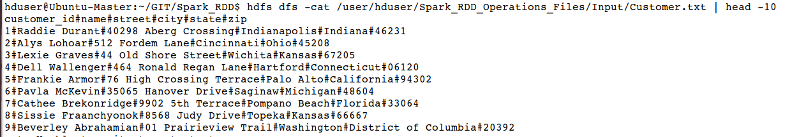
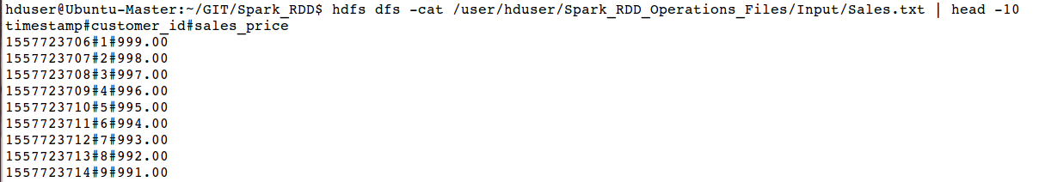
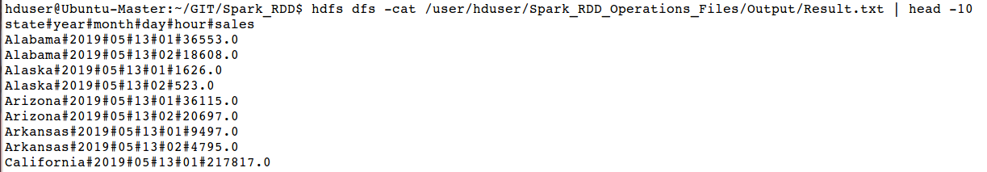
Sample Input and Output Files
Input Files:
Output Files:

Slide 8
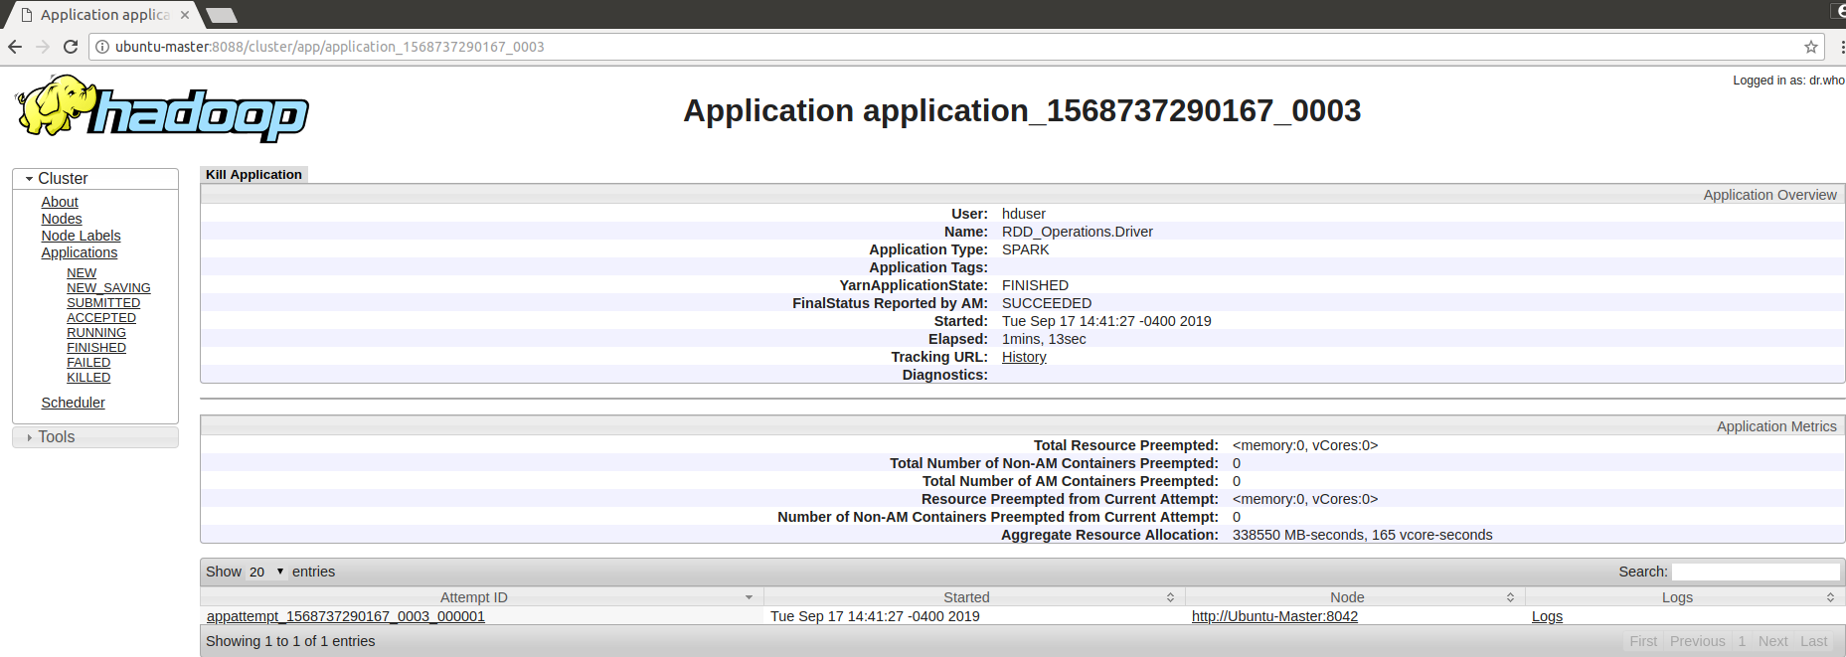
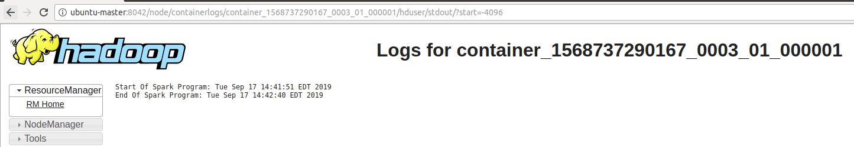
YARN Logs

Slide 9
Cluster Configuration
S.No | Component | Version / Details
1 | Java | 1.8.0_144
2 | Ubuntu | 14.04 LTS
3 | Hadoop | 2.7.1
4 | SPARK | 2.4.3
5 | SCALA | 2.11.12
6 | Nodes in cluster | 1
7 | yarn.scheduler.maximum-allocation-mb | 3072 MB (3 GB)
7 | spark.driver.memory | 1024m
8 | spark.yarn.am.memory | 1024m
9 | spark.executor.memory | 1024m
10 | spark.executor.memoryOverhead | 384m

Slide 10
Job Statistics
S.No | Files | Process | Mode | Data Size (KB) | Job Run Time (Minutes:Seconds)
1 | Customer_File | SPARK | Cluster | 61.58 | 0:50
2 | Sales_File | SPARK | Cluster | 115.87
3 | Customer_File | SPARK | Client | 61.58 | 1:45
4 | Sales_File | SPARK | Client | 115.87
5 | Customer_File | SPARK | Local | 61.58 | 0:12
6 | Sales_File | SPARK | Local | 115.87

